Slide 1
Object Oriented Programming CSE 2101 Lecture - 01
Jubayer Al Mahmud
Lecturer
Jashore University of Science & Technology

Slide 2
Outline
Is Java still relevant?
History of OOP Language
History of Java
Object-Oriented Programming System
What’s an Object?
Features of Java
Basics of Java Environments
Versions of Java

Slide 3
Is Java still relevant?
Learning Java in 2024 remains highly relevant for several reasons:
Widespread Use: Java is still one of the most popular programming languages globally, especially for enterprise-level applications, Android development, and backend systems. Companies like Amazon, Google, and financial institutions continue to rely heavily on Java for building scalable, secure, and high-performance systems.
Enterprise and Backend Systems: Many large-scale business applications, including those in banking, insurance, and e-commerce, are built using Java due to its stability, security, and vast ecosystem of tools and frameworks (e.g., Spring, Hibernate). Learning Java is crucial for maintaining or building these systems.
Cross-Platform Capability: Java’s “write once, run anywhere” (WORA) capability still makes it a go-to choice for developing cross-platform applications. This feature is particularly important in environments where software needs to be deployed on different operating systems without major modifications.

Slide 4
Is Java still relevant?
Android Development: Java remains a core language for Android development, though Kotlin is now a preferred option for new Android projects. However, many existing Android apps and legacy systems still rely on Java.
Big Data and Cloud: Java is a key language for Big Data technologies (e.g., Hadoop, Spark) and is also widely used in cloud-based applications. The cloud ecosystem, including platforms like AWS and Google Cloud, supports Java-based applications due to their reliability and performance.
Job Opportunities: Java skills are highly sought after, with many job openings in software development, especially in backend engineering and Android development.
Learning Foundations: Java’s object-oriented programming (OOP) principles make it an excellent language for learning fundamental programming concepts. These concepts are transferable to other languages, making Java a good foundation for further learning.
In summary, Java’s relevance in 2024 lies in its strong presence in enterprise solutions, mobile development, cloud computing, and a wide job market.

Slide 5
History of OOP Language
Simula (1962) is considered the first object-oriented programming language. The programming paradigm where everything is represented as an object is known as a truly object-oriented programming language.
Smalltalk (1970) is considered the first truly object-oriented programming language.

Slide 6
History of Java
Java is a general purpose object oriented programming language.
Developed by Sun Microsystems. (James Gosling)
Initially called “Oak” but was renamed as “Java” in 1995.
Initial motivation is to develop a platform independent language to create software to be embedded in various consumer electronics devices.
Become the language of internet. (portability and security).

Slide 7
Object-Oriented Programming System
Object means a real-world entity such as a pen, chair, table, computer, watch, etc.
Object-Oriented Programming is a methodology or paradigm to design a program using classes and objects.
It simplifies software development and maintenance by providing some concepts:
Object
Class
Inheritance
Polymorphism
Abstraction
Encapsulation

Slide 8
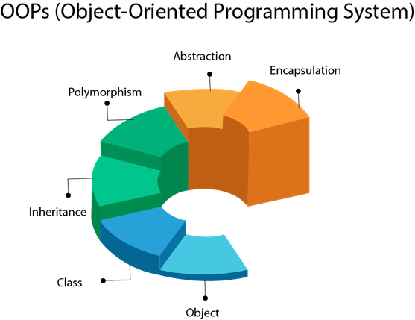

Slide 9
Object-Oriented Programming System
Apart from those concepts, there are some other terms which are used in Object-Oriented design:
Coupling
Coupling refers to the degree of direct knowledge that one element has of another. In other words, how often do changes in class A force related changes in class B.
// tight coupling concept
class Subject {
Topic t = new Topic();
public void startReading()
{
t.understand();
}
}
class Topic {
public void understand()
{
System.out.println("Tight coupling concept");
}
}
In this program the Subject class is dependents on Topic class. In the program Subject class is tightly coupled with Topic class it means if any change in the Topic class requires Subject class to change. For example, if Topic class understand() method change to gotit() method then you have to change the startReading() method calling gotit() method instead of calling understand() method.

Slide 10
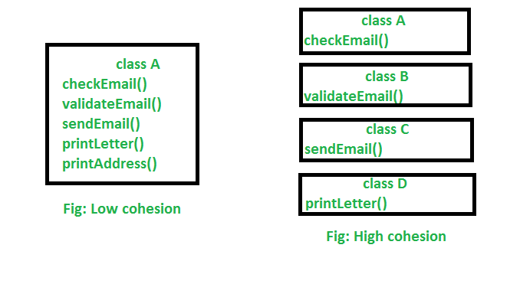
Object-Oriented Programming System
Apart from those concepts, there are some other terms which are used in Object-Oriented design:
Cohesion
Cohesion refers to how a single class is designed. Suppose we have a class that multiplies two numbers, but the same class creates a pop-up window displaying the result. This is an example of a low cohesive class because the window and the multiplication operation don’t have much in common. To make it high cohesive, we would have to create a class Display and a class Multiply. The Display will call Multiply method to get the result and display it.

Slide 11
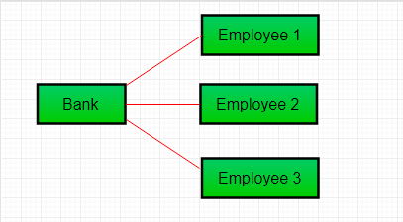
Object-Oriented Programming System
Apart from those concepts, there are some other terms which are used in Object-Oriented design:
Association
A relation between two separate classes which establishes through their Objects. Association can be one-to-one, one-to-many, many-to-one, many-to-many. An Object communicates to another object to use functionality and services provided by that object. Composition and Aggregation are the two forms of association.
In this figure, two separate classes Bank and Employee are associated through their Objects. Bank can have many employees, So it is a one-to-many relationship.

Slide 12
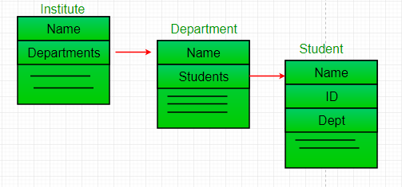
Object-Oriented Programming System
Apart from those concepts, there are some other terms which are used in Object-Oriented design:
Aggregation
It represents Has-A’s relationship.
It is a unidirectional association i.e. a one-way relationship. For example, a department can have students but vice versa is not possible and thus unidirectional in nature.
Both entries can survive individually which means ending one entity will not affect the other entity.

Slide 13
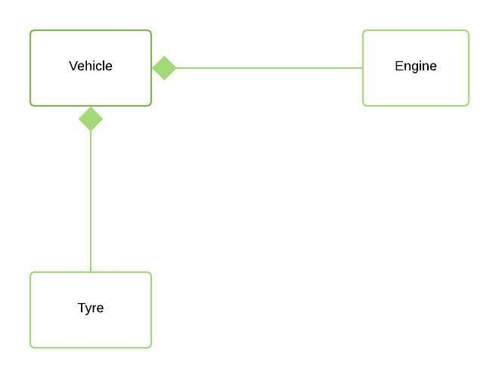
Object-Oriented Programming System
Apart from those concepts, there are some other terms which are used in Object-Oriented design:
Composition
It represents part-of relationship.
In composition, both entities are dependent on each other.
When there is a composition between two entities, the composed object cannot exist without the other entity.

Slide 14
What’s an Object?
Any entity that has state and behavior is known as an object.
For example, a chair, pen, table, keyboard, bike, etc. It can be physical or logical.
An Object can be defined as an instance of a class.
An object contains an address and takes up some space in memory.
Objects can communicate without knowing the details of each other's data or code.

Slide 15
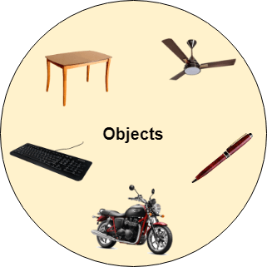
What’s an Object?
The only necessary thing is the type of message accepted and the type of response returned by the objects.
Example: A dog is an object because it has states like color, name, breed, etc. as well as behaviors like wagging the tail, barking, eating, etc.

Slide 16
Features of Java
Simple, Small and Familiar
Compiled and Interpreted
Object Oriented
Platform Independent and portable
Robust and Secure
Distributed / Network Oriented
Multithreaded and Interactive
High Performance
Dynamic

Slide 17
Simple, Small and Familiar
Similar to C/C++ in syntax
But eliminates several complexities of
No operator overloading
No direct pointer manipulation or pointer arithmetic
No multiple inheritance
No malloc() and free(). Handles memory automatically

Slide 18
Compiled and Interpreted
Java works in two stage
Java compiler translate the source code into byte code.
Java interpreter converts the byte code into machine level representation.
Byte Code:
A highly optimized set of instructions to be executed by the java runtime system, known as java virtual machine (JVM).

Slide 19
Java Virtual Machine
Java compiler produces an intermediate code known as byte code for a machine, known as JVM.
It exists only inside the computer memory.
Machine code is generated by the java interpreter by acting as an intermediary between the virtual machine and real machine.
Java Program
Java Compiler
Virtual Machine
Bytecode
Java Interpreter
Machine Code

Slide 20
Object Oriented
Fundamentally based on OOP
Classes and Objects
Efficient re-use of packages such that the programmer only cares about the interface and not the implementation
The object model in java is simple and easy to extend.

Slide 21
Platform Independent and Portable
“Write-Once Run-Anywhere”
Changes in system resources will not force any change in the program.
The Java Virtual Machine (JVM) hides the complexity of working on a particular platform
Convert byte code into machine level representation.

Slide 22
Robust and Secure
Designed with the intention of being secure
No pointer arithmetic or memory management!
Strict compile time and run time checking of data type.
Exception handling
It verify all memory access
Ensure that no viruses are communicated with an applet.

Slide 23
Distributed and Network Oriented
Java grew up in the days of the Internet
Inherently network friendly
Original release of Java came with Networking libraries
Newer releases contain even more for handling distributed applications

Slide 24
Multithreaded and Interactive
Handles multiple tasks simultaneously.
Java runtime system contains tools to support multi-process synchronization and construct smoothly running interactive systems.

Slide 25
High Performance
Java performance is slower than C
Provisions (to make something available such as library, configuration) are added to reduce overhead at runtime.
Incorporation of multithreading enhance the overall execution speed.
Just-in-Time (JIT) can compile the byte code into machine code.
Can sometimes be even faster than compiled C code!

Slide 26
Dynamic
Capable of dynamically linking a new class libraries, methods and objects.
Java can use efficient functions available in C/C++.
Installing new version of library automatically updates all programs

Slide 27
Language of Internet Programming
Java Applets
Security
Portability
Applets
Special java program that can transmitted over the network and automatically executed by a java-compatible web browser.
Security
Java compatible web browser can download java applets without fear of viral infection and malicious agent.
Portable
Java applets can be dynamically downloaded to all the various types of platforms connected to the internet

Slide 28
Why portable and Secure?
The output of java compiler is not executable code.
Once JVM exists for a platform, any java program can run on it.
The execution of byte code by the JVM makes java programs portable.
Java program is confined within the java execution environment and cannot access the other part of the computer.

Slide 29
Basics of Java Environments
Java programs normally undergo five phases
Edit
Programmer writes program (and stores program on disk)
Compile
Compiler creates bytecodes from program
Load
Class loader stores bytecodes in memory
Verify
Verifier ensures bytecodes do not violate security requirements
Execute
Interpreter translates bytecodes into machine language

Slide 30
Program is created in an editor and stored on disk in a file ending with .java.
Phase 1
Editor
Disk
Compiler
Compiler creates bytecodes and stores them on disk in a file ending with .class.
Phase 2
Disk
Primary
Memory
Phase 3
Class Loader
Class loader reads .class files containing bytecodes from disk and puts those bytecodes in memory.
Disk
.
.
.
.
.
.
Primary
Memory
Phase 4
Bytecode Verifier
Bytecode verifier confirms that all bytecodes are valid and do not violate Java’s security restrictions.
.
.
.
.
.
.
Primary
Memory
Interpreter reads bytecodes and translates them into a language that the computer can understand, possibly storing data values as the program executes.
Phase 5
Interpreter
.
.
.
.
.
.

Slide 31
Java Environment
Development tools-part of java development kit (JDK)
Classes and methods-part of Java Standard Library (JSL), also known as Application Programming Interface (API)
JDK:
Appletviewer ( for viewing applets)
Javac (Compiler)
Java (Interpreter)
Javap (Java disassembler)
Javadoc ( for creating HTML description)
Jdb (Java Debugger)

Slide 32
Java Environment
Application Package Interface (API)
Contains hundreds of classes and methods grouped into several functional packages:
Language Support Package
Utility Packages
Input/ Output Packages
Networking Packages
JDBC (Java Database Connectivity is an API which defines how a client may access a database)
AWT Package
The java.awt package provides classes for AWT API such as TextField, Label, TextArea, RadioButton, CheckBox, Choice, List etc.
Applet Package
Java Applet is a special type of small Java program embedded in the webpage to generate dynamic content. The specialty of the Java applet is it runs inside the browser and works on the Client side (No longer used).

Slide 33
Versions of Java
Three versions of the Java Platform, targeted at different uses
Java Platform Micro Edition (Java ME)
Very small Java environment for smart phones, personal digital assistant (PDA), etc
Subset of the standard Java libraries aimed at limited size and processing power
Java Platform Standard Edition (Java SE)
The basic platform
Java SE can be used to develop client-side standalone applications or applets.

Slide 34
Versions of Java
Java Platform Enterprise Edition (Java EE)
For business applications, web services, mission-critical systems
Transaction processing, databases, distribution, replication

Slide 35
Thank You

